Slide 1
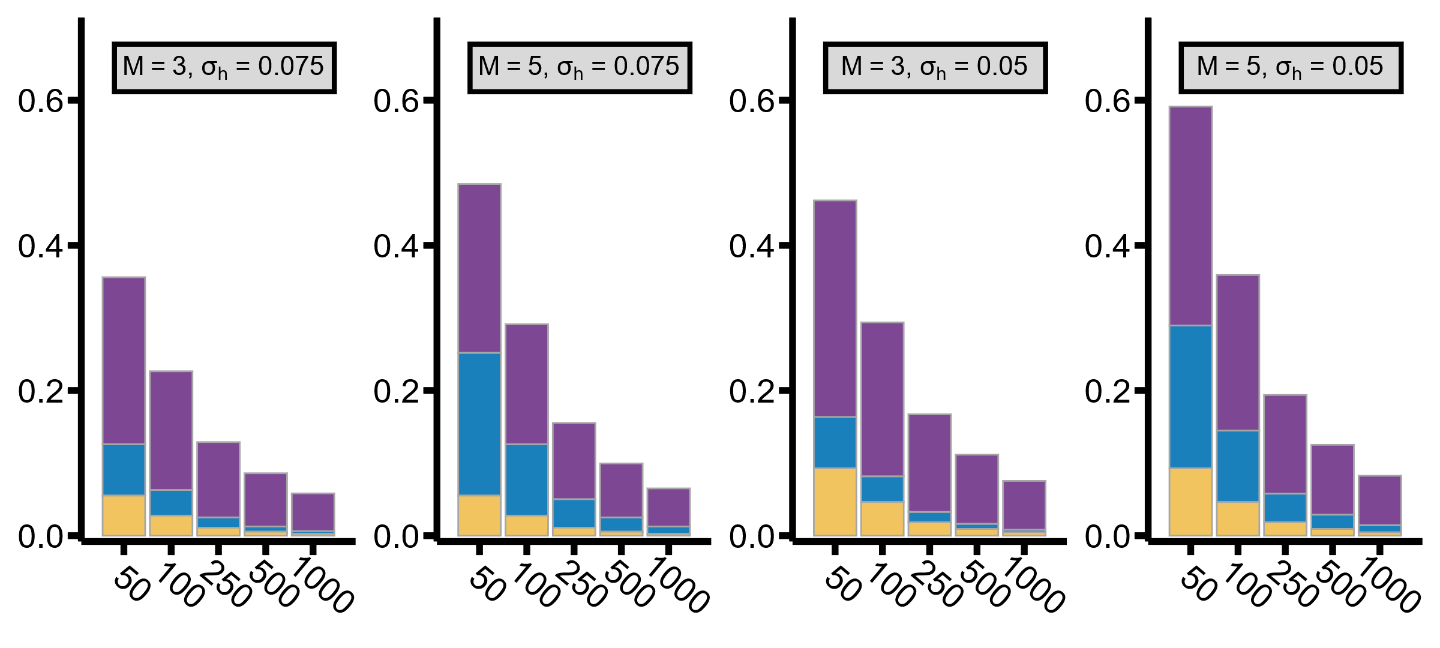
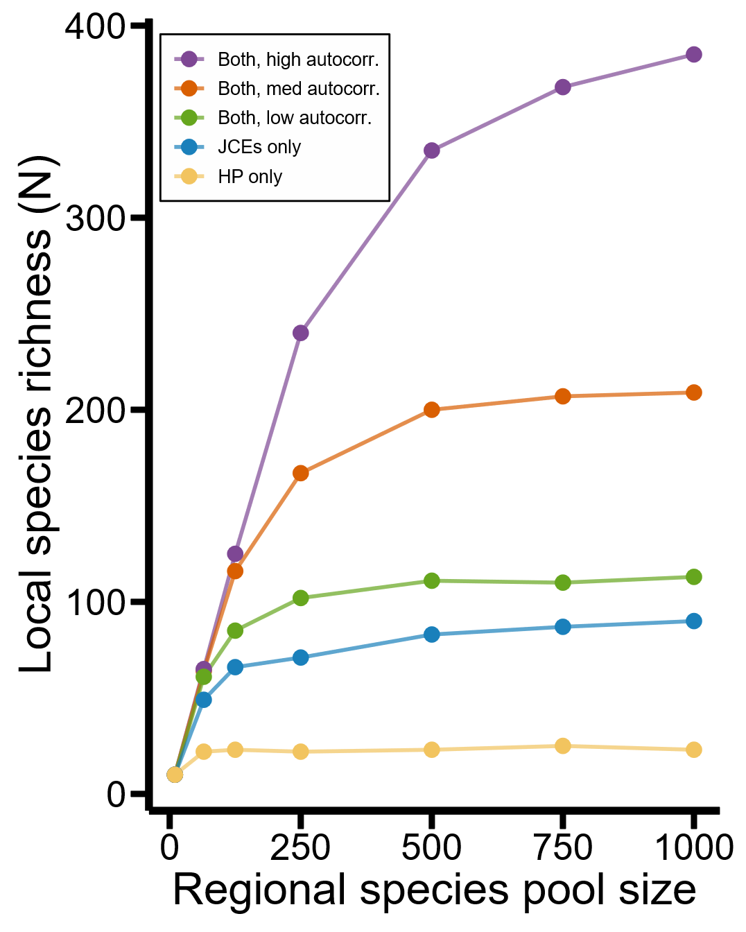
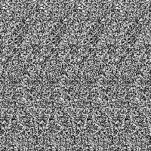
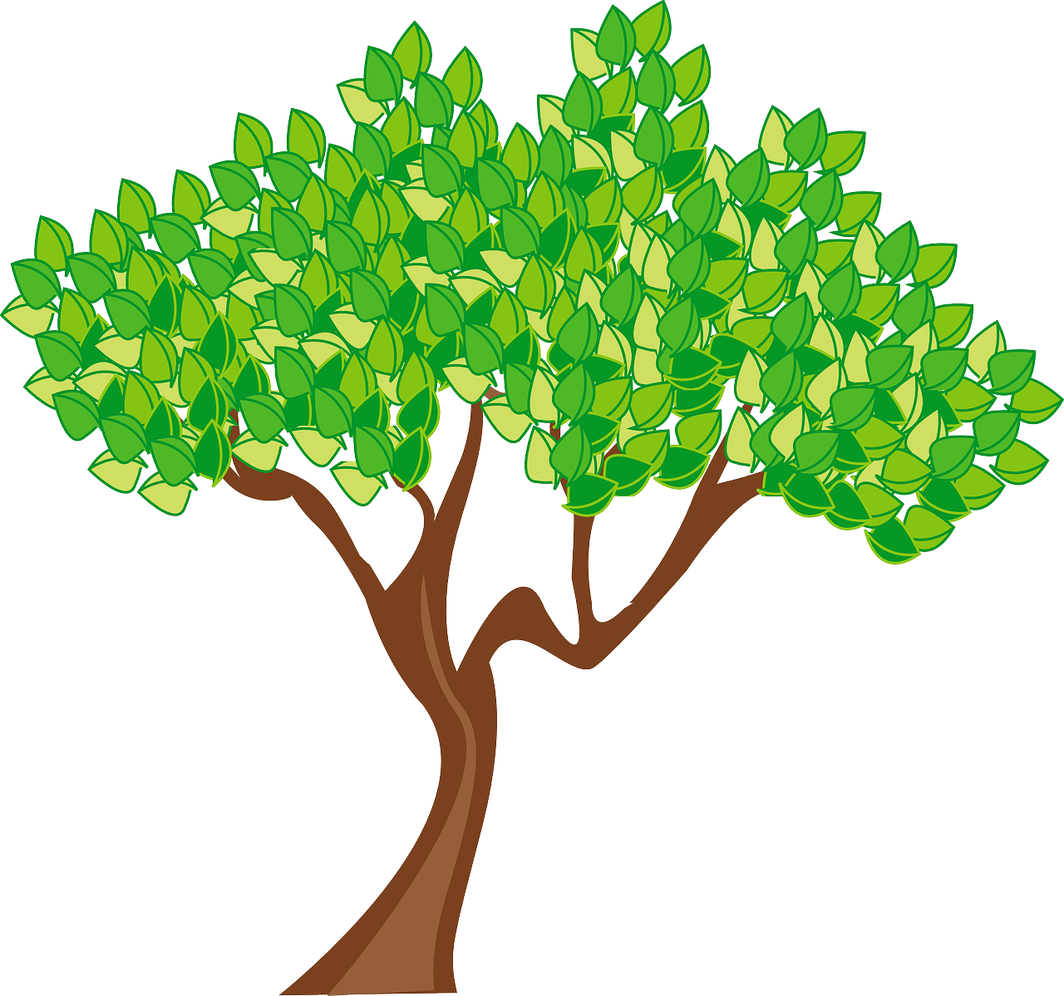
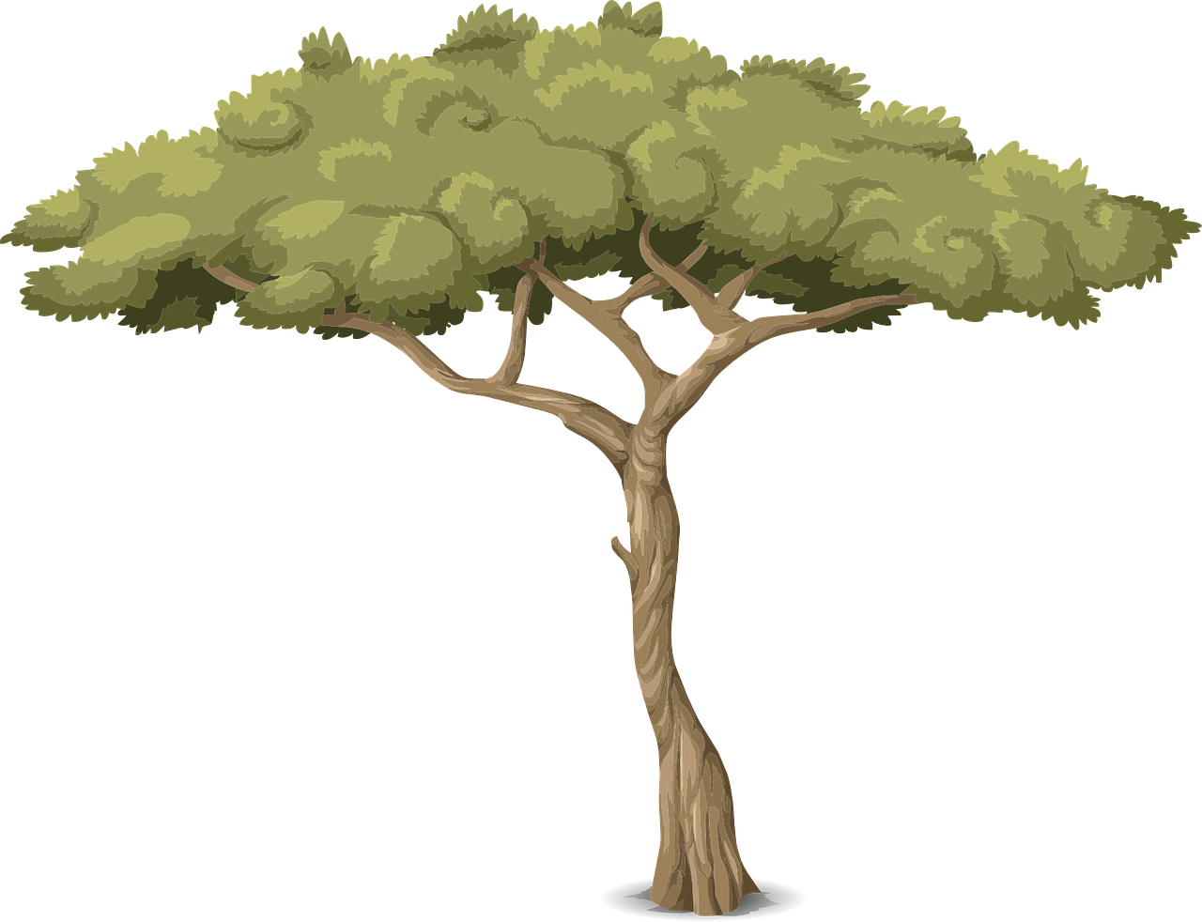

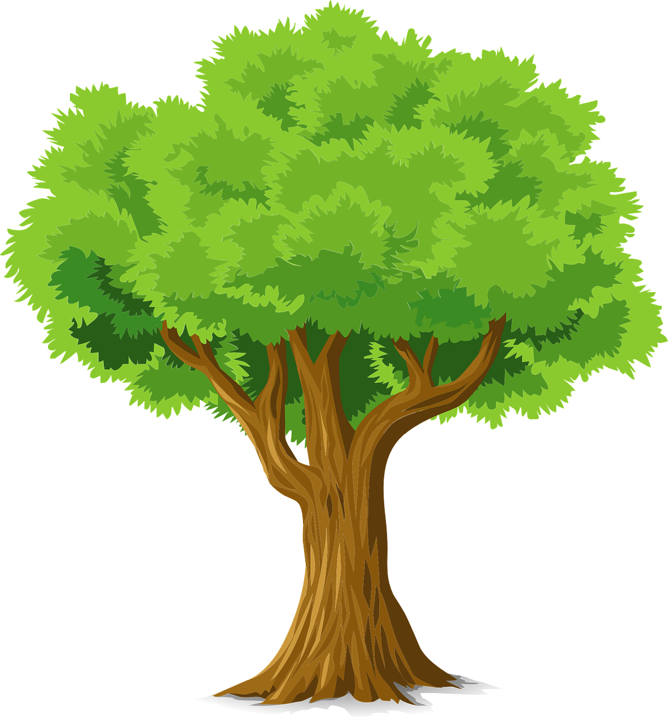
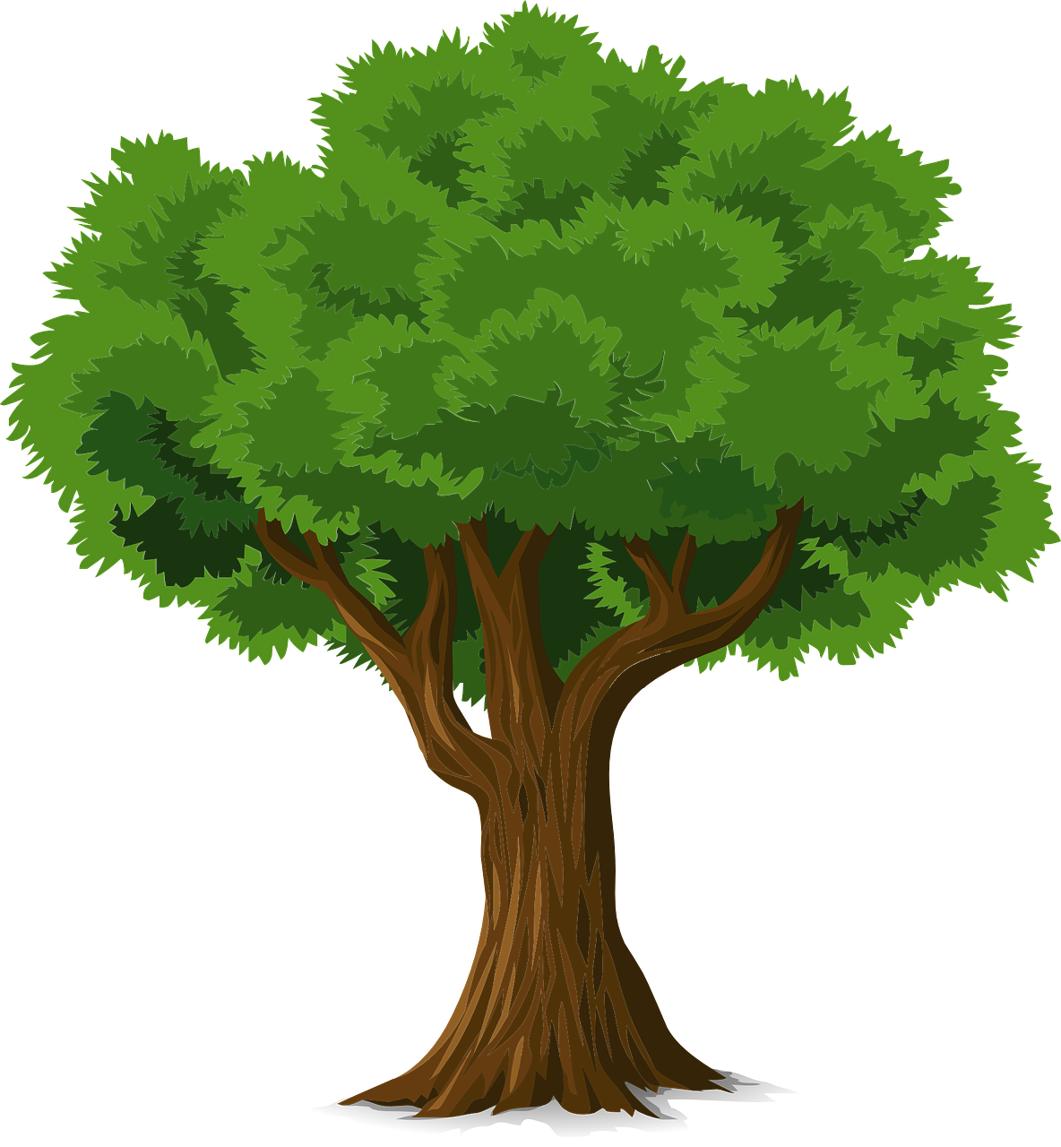

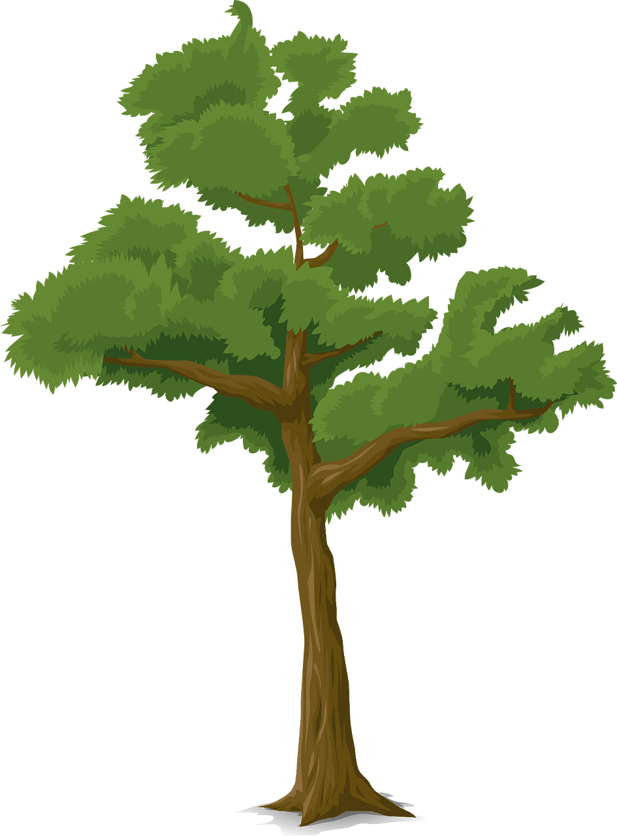
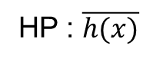




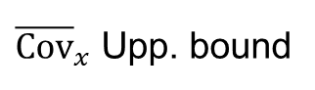

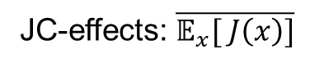
A
B
C
D
${\overline{Cov}}_{x}$ Upp. bound
Stabilizing effect
JC-effects: $\overline{{\text{𝔼}}_{x}[ J\left(x\right)]}$
HP : $\overline{h(x)}$
$N$ (number of resident species / local species richness)
E
F
G
~ panel E
$${\overline{Cov}}_{x}\left(J\left(x\right),H\left(x\right)/ρ\right)>0$$
$${\overline{Cov}}_{x}\left(J\left(x\right),H\left(x\right)/ρ\right)≈0$$
Focal
patch
Focal
patch
~ panel F
$5×5$ Moore Neighborhood
5$×5$ Moore Neighborhood

